Slide 1
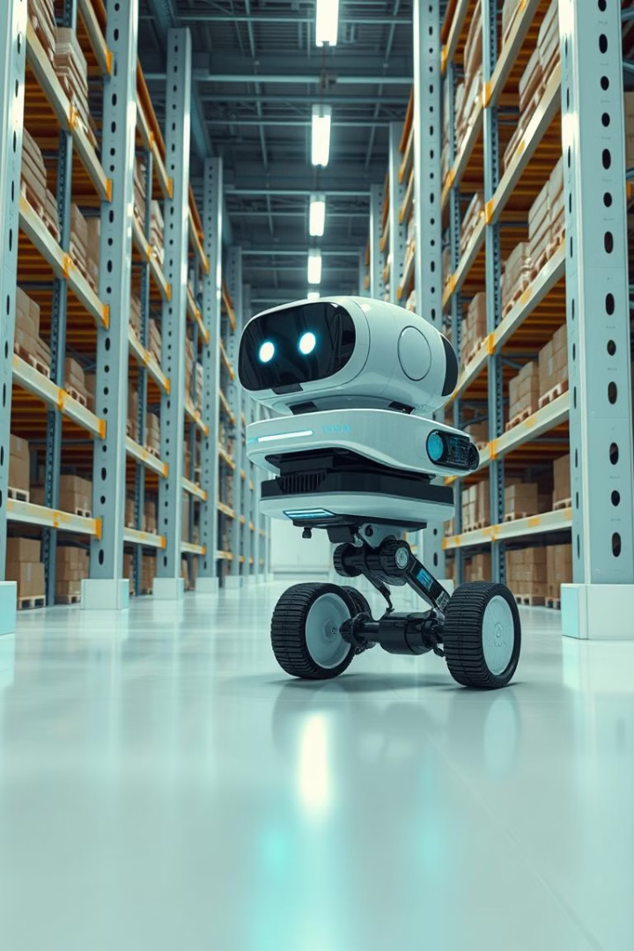
Autonomous Vehicle Navigation System
A Capstone Project
This project enhances warehouse efficiency. It uses autonomous robots for navigation. The robots read orders and warehouse layouts.
by Thrishala, Soumith, Dhruv, Afifa

Slide 2




Knapsack & Traveling Salesperson Problem
We utilized the Knapsack problem to optimize item selection. The Traveling Salesperson Problem (TSP) determined shortest routes. This combination ensures efficiency.
Knapsack
TSP
Optimization

Slide 3
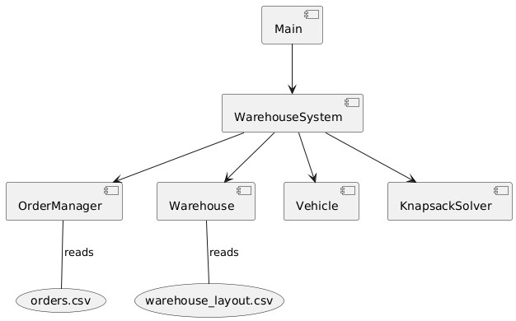
Challenge
Minimizing travel distance. Also, reducing order processing time. Implementing shortest distance in a warehouse system.
Solution
Autonomous navigation system. It optimizes routes effectively. It implements OOPs concepts of modularity and SOLID principles such as SRP.
Encapsulation:
Each class (Order, Product, Vehicle, Warehouse, OrderManager, KnapsackSolver) encapsulates its data (member variables) and behavior (member functions).
Abstraction:
Classes provide abstract representations of real-world entities. For example, the Vehicle class abstracts the behavior of a vehicle in the warehouse, and the Warehouse class abstracts the warehouse layout.

Slide 4
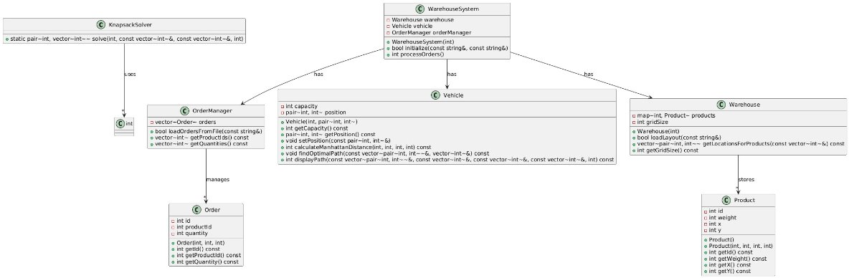
Object-Oriented Programming (OOPs) Approach
OOP concepts improved code organization. Class diagrams define system architecture. This approach provides modularity and maintainability.

Slide 5




Future Improvements and Scalability
Future work includes improving algorithms. Enhancing scalability is crucial for larger warehouses. This ensures the system can adapt to evolving needs.
Algorithm
Improve pathfinding
Scalability
Support larger warehouses
Enhancements
Further optimization

